Slide 1
Introduction to Edmodo

Slide 2
Edmodo’s mission is to connect all learners with the people and resources they need to reach their full potential.

Slide 3
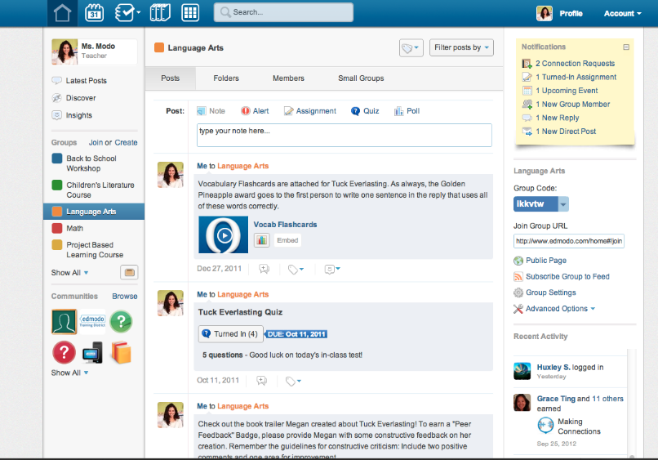
Free and Secure Social Learning Platform
Assignments are posted, submitted, and graded online
Quizzes and polls gather real-time assessments
Engaging, interactive 3rd party digital apps
Library offers unlimited storage
Private groups for classes, clubs, PLCs, PD , etc.
Collaborative space for discussions and sharing content like links and videos
Teachers join communities to connect with other teachers on various subjects
Notes:
Edmodo is a free and secure social learning platform where teachers and students can collaborate, share content, and use educational apps to augment in-classroom learning. Accessible from any device with Internet capabilities, Edmodo provides a safe and easy way to connect and support anytime, anyplace learning. Edmodo is helping to evolve the classroom into a personalized learning environment that engages and meets the needs of diverse 21st century learners.

Slide 4
Largest, Fastest Growing Social Learning Platform
Over 19 Million users worldwide
27% of U.S. teachers use Edmodo
2012: 15M users
2011: 4.8M users
2010: 1.1M users
2009: 225K users
SOURCE: Edmodo Internal data and MMS Education; edWeb; MCH Strategic Data
Notes:
On Edmodo, teachers are at the center of a powerful network that connects them to students, administrators, parents, and publishers.
In just over four years, Edmodo has formed a powerful network of more than 15 millions users from around the world.
What’s amazing is that this growth has largely been driven by teacher-led, grassroots adoption.

Slide 5
Why Edmodo?
Safe environment controlled by teacher
Easy to use
Engaging for students
Relevant for 21st century learners
Time-Saving features
Unlimited storage
Accessible anytime, anyplace
Global connections

Slide 6
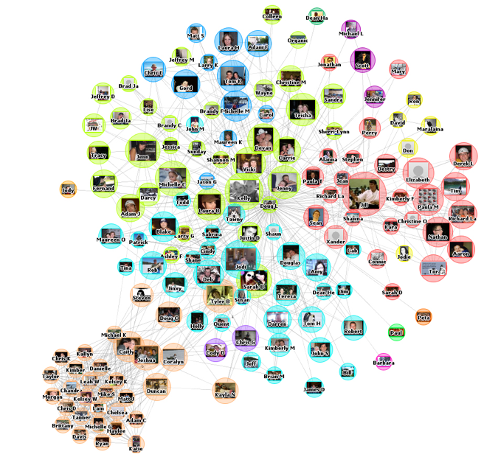
Connect and Collaborate with All Stakeholders
Superintendent
Curriculum & Instruction
Parents
Professional Development
Media Specialists
Teachers
Tutors
Cabinet
Principals
Technology
Counselors
Students

Slide 7
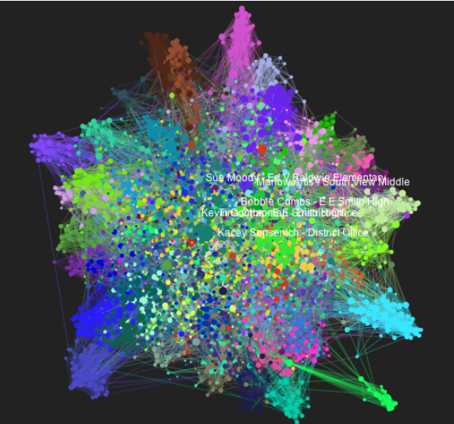
The Power of the Network!

Slide 8
The Edmodo Network
Connecting 19 Million Teachers and Students Worldwide

